Slide 1
Scale of Assessment of Members’ Contributions
Cg-19/Doc. 6.3(2) 30 May 2023

Slide 2
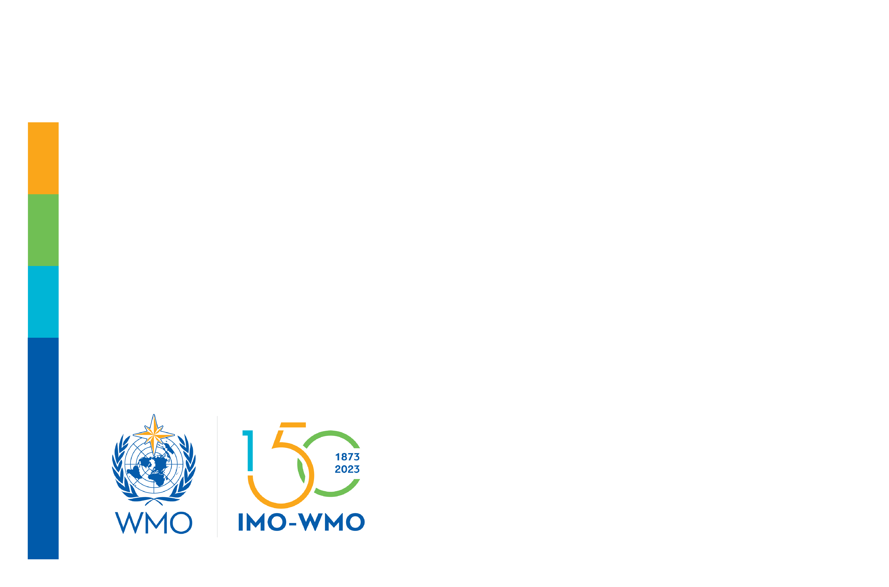
Basis for WMO Scale of Assessment
WMO Scale of Assessment always based upon UN Scale
UN publishes new scale every 3 years
WMO 2020-2022 was based upon UN Scale available in December 2018
WMO 2023 scale approved by EC-75 considering UN Scale available in December 2021
Proposed 2024-2025 scale based upon application of UN Scale:
No change from EC approved WMO scale for 2023
Relevant UN Scale approved December 2021
No individual Member increase exceeded 200% of the WMO Scale in 2022
Rates for 2026-2027 to be determined:
By Executive Council at EC meeting in June 2025
Based upon UN Scale to be approved in December 2024
 | 2

Slide 3
FINAC Recommendation
Recommendation 3:
“That Congress adopts draft Resolution 6.3(2) (Cg-19) – Assessment of Proportional Contributions of Members for the Nineteenth Financial Period”
 | 3

Slide 4
Resolution 6.3(2)/1 (Cg-19)
Decides:
That the latest United Nations scales of assessments to be approved by the United Nations General Assembly should continue to be used as the basis for the calculation of the WMO scales of assessments, duly adjusted for differences in membership, as specified in Table 1 of the annex to this resolution;
That the scales of assessments of proportional contributions of Members for the nineteenth financial period (2024–2027) shall be based on the United Nations scales of assessments adopted by the United Nations General Assembly at its seventy-sixth (2021) and seventy-ninth (2024) sessions, adjusted for differences in membership;
That the proportional contributions of countries which are not Members but which may become Members shall be assessed as shown in Table 2 of the annex to this resolution;
 | 4

Slide 5
Resolution 6.3(2)/1 (Cg-19)
Authorizes the Executive Council:
To adjust the scales of assessment for the years 2026 and 2027 using the United Nations scales of assessment to be adopted by the United Nations General Assembly in the year 2024, adjusted for differences in membership provided that, for the WMO scale, the minimum rate shall remain at 0.02% and corrections shall be made to ensure that no Member’s rate of assessment would increase to a level which would exceed 200% of the WMO scale in 2025;
To make a provisional assessment in respect of non-Members in the event of any such non-Members becoming Members, the method of assessment being based on principles similar to those governing the assessments laid down in this resolution.
 | 5

Slide 6
Thank you
^{wmo.int}

